Slide 1
Data Structure and Algorithms
(CS212)
Instructor : Syed Musharaf Ali
ROOM G-104-DSE IIUI
Ph# 051-9019724 Ext-2724
Email: musharaf.ali@iiu.edu.pk

Slide 2
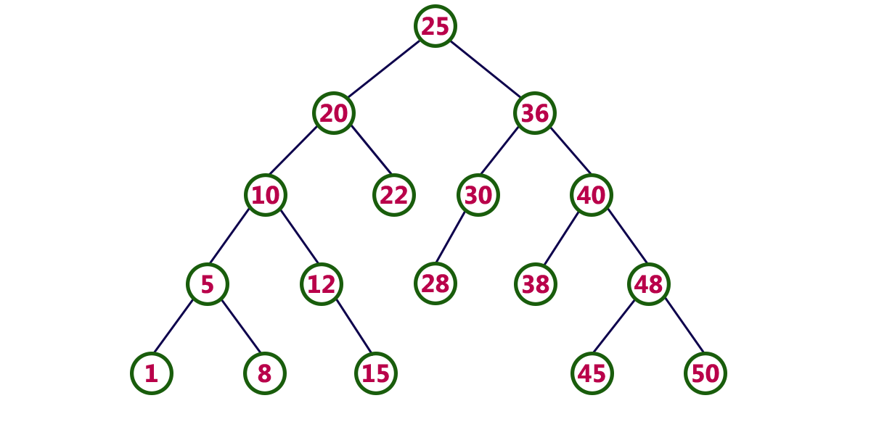
Binary Search Tree (BST)

Slide 3
Search Operation in BST
In a binary search tree, the search operation is performed with O(log n) time complexity. The search operation is performed as follows...
Step 1: Read the search element from the user
Step 2: Compare, the search element with the value of root node in the tree.
Step 3: If both are matching, then display "Given node found!!!" and terminate the function
Step 4: If both are not matching, then check whether search element is smaller or larger than that node value.
Step 5: If search element is smaller, then continue the search process in left subtree.
Step 6: If search element is larger, then continue the search process in right subtree.
Step 7: Repeat the same until we found exact element or we completed with a leaf node
Step 8: If we reach to the node with search value, then display "Element is found" and terminate the function.
Step 9: If we reach to a leaf node and it is also not matching, then display "Element not found" and terminate the function.

Slide 4
Insertion Operation in BST
In a binary search tree, the insertion operation is performed with O(log n) time complexity. In binary search tree, new node is always inserted as a leaf node. The insertion operation is performed as follows...
Step 1: Create a newNode with given value and set its left and right to NULL.
Step 2: Check whether tree is Empty.
Step 3: If the tree is Empty, then set root to newNode.
Step4:If the tree is Not Empty, then check whether value of newNode is smaller or larger than the node (here it is root node).
Step 5: If newNode is smaller than or equal to the node, then move to its left child. If newNode is larger than the node, then move to its right child.
Step 6: Repeat the above step until we reach to a leaf node (e.i., reach to NULL).
Step 7: After reaching a leaf node, then insert the newNode as left child if newNode is smaller or equal to that leaf else insert it as right child.

Slide 5
Deletion Operation BST
http://quiz.geeksforgeeks.org/binary-search-tree-set-2-delete/
1) Node to be deleted is leaf: Simply remove from the tree.

Slide 6
Deletion Operation BST
http://quiz.geeksforgeeks.org/binary-search-tree-set-2-delete/
2) Node to be deleted has only one child: Copy the child to the node and delete the child

Slide 7
Deletion Operation BST
http://quiz.geeksforgeeks.org/binary-search-tree-set-2-delete/
3) Node to be deleted has two children: Find inorder successor of the node. Copy contents of the inorder successor to the node and delete the inorder successor. Note that inorder predecessor can also be used.

Slide 8
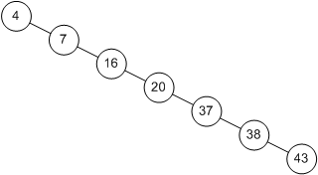
Binary Search Tree Problem
In this case time complexity is O(n)

Slide 9
AVL Tree
http://btechsmartclass.com/DS/U5_T2.html
AVL tree is a self balanced binary search tree.
That means, an AVL tree is also a binary search tree but it is a balanced tree. A binary tree is said to be balanced, if the difference between the heights of left and right subtrees of every node in the tree is either -1, 0 or +1.
In other words, a binary tree is said to be balanced if for every node, height of its children differ by at most one.
In an AVL tree, every node maintains a extra information known as balance factor.
The AVL tree was introduced in the year of 1962 by G.M. Adelson-Velsky and E.M. Landis.

Slide 10
AVL Tree
http://btechsmartclass.com/DS/U5_T2.html
Definition:
An AVL tree is a balanced binary search tree. In an AVL tree, balance factor of every node is either -1, 0 or +1.
Balance factor = heightOfLeftSubtree – heightOfRightSubtree
Balance factor of a node is the difference between the heights of left and right subtrees of that node. The balance factor of a node is calculated either height of left subtree - height of right subtree (OR) height of right subtree - height of left subtree. In the following explanation, we are calculating as follows...

Slide 11
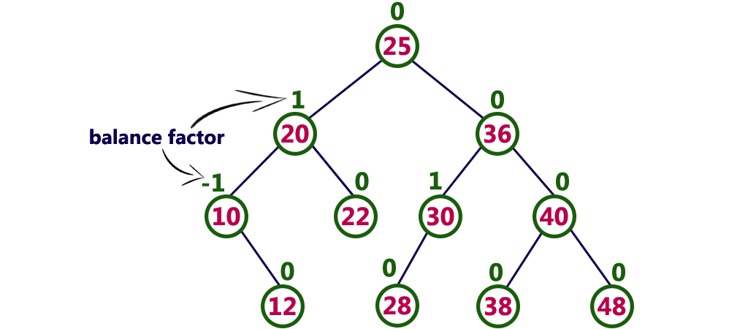
AVL Tree
http://btechsmartclass.com/DS/U5_T2.html
The above tree is a binary search tree and every node is satisfying balance factor condition. So this tree is said to be an AVL tree.

Slide 12
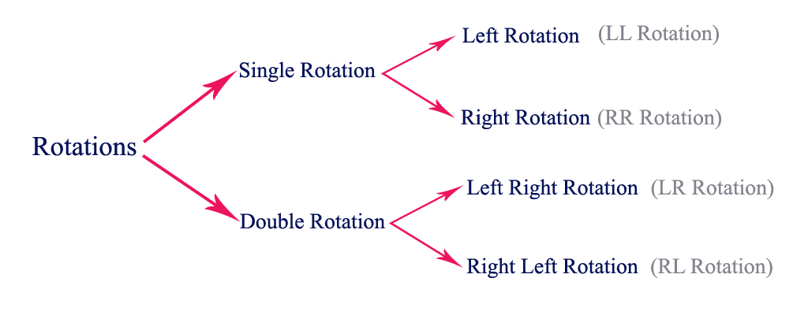
AVL Tree Rotations http://btechsmartclass.com/DS/U5_T2.html
Rotation is the process of moving the nodes to either left or right to make tree balanced.
There are four rotations and they are classified into two types.

Slide 13
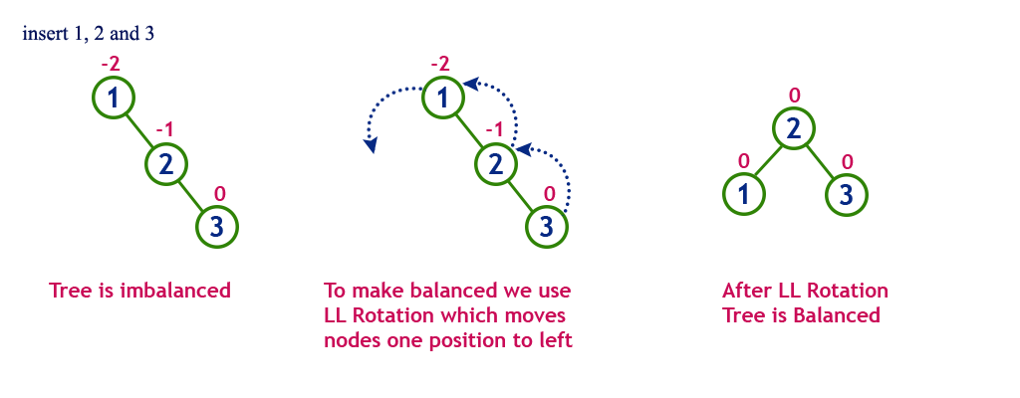
AVL Tree Rotations http://btechsmartclass.com/DS/U5_T2.html
(1) Single Left Rotation (LL Rotation)
In LL Rotation every node moves one position to left from the current position. To understand LL Rotation, let us consider following insertion operations into an AVL Tree...

Slide 14
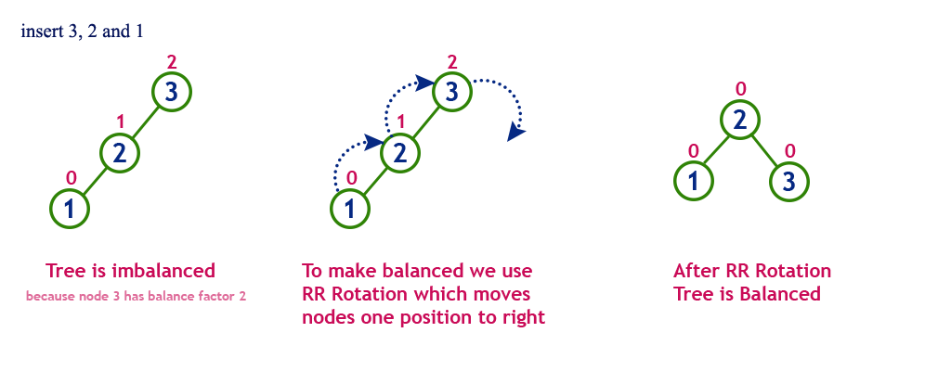
AVL Tree Rotations http://btechsmartclass.com/DS/U5_T2.html
(2) Single Right Rotation (RR Rotation)
In RR Rotation every node moves one position to right from the current position. To understand RR Rotation, let us consider following insertion operations into an AVL Tree...

Slide 15
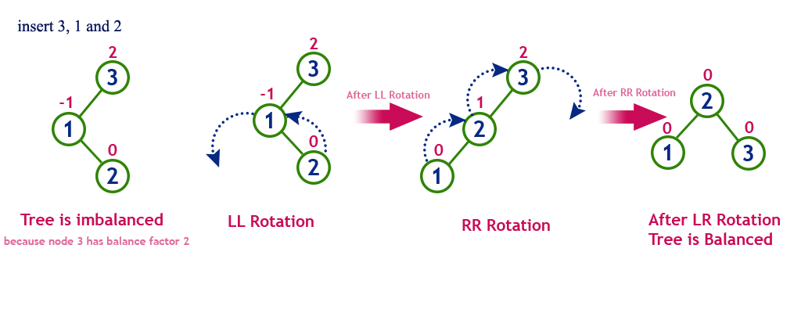
AVL Tree Rotations http://btechsmartclass.com/DS/U5_T2.html
(3) Left Right Rotation (LR Rotation)
The LR Rotation is combination of single left rotation followed by single right rotation. In LR Rotation, first every node moves one position to left then one position to right from the current position. To understand LR Rotation, let us consider following insertion operations into an AVL Tree...

Slide 16
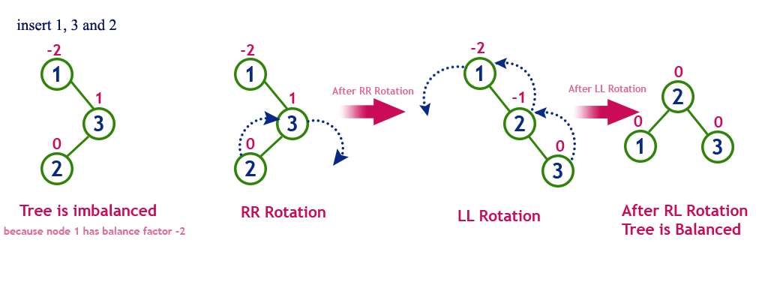
AVL Tree Rotations http://btechsmartclass.com/DS/U5_T2.html
(4) Right Left Rotation (RL Rotation)
The RL Rotation is combination of single right rotation followed by single left rotation. In RL Rotation, first every node moves one position to right then one position to left from the current position. To understand RL Rotation, let us consider following insertion operations into an AVL Tree...

Slide 17
Search Operation in AVL Tree
In an AVL tree, the search operation is performed with O(log n) time complexity. The search operation is performed similar to Binary search tree search operation. We use the following steps to search an element in AVL tree...
Step 1: Read the search element from the user
Step 2: Compare, the search element with the value of root node in the tree.
Step 3: If both are matching, then display "Given node found!!!" and terminate the function
Step 4: If both are not matching, then check whether search element is smaller or larger than that node value.
Step 5: If search element is smaller, then continue the search process in left subtree.
Step 6: If search element is larger, then continue the search process in right subtree.
Step 7: Repeat the same until we found exact element or we completed with a leaf node
Step 8: If we reach to the node with search value, then display "Element is found" and terminate the function.
Step 9: If we reach to a leaf node and it is also not matching, then display "Element not found" and terminate the function.

Slide 18
Insertion Operation in AVL Tree
In an AVL tree, the insertion operation is performed with O(log n) time complexity. In AVL Tree, new node is always inserted as a leaf node. The insertion operation is performed as follows...
Step 1: Insert the new element into the tree using Binary Search Tree insertion logic.
Step 2: After insertion, check the Balance Factor of every node.
Step 3: If the Balance Factor of every node is 0 or 1 or -1 then go for next operation.
Step 4: If the Balance Factor of any node is other than 0 or 1 or - 1 then tree is said to be imbalanced. Then perform the suitable Rotation to make it balanced. And go for next operation.

Slide 19
Insertion Operation in AVL Tree
Example: Construct an AVL Tree by inserting numbers from 1 to 8.
See: http://btechsmartclass.com/DS/U5_T2.html

Slide 21
